Slide 1
2023 Citywide Revaluation
Michelle Laube
City Assessor

Slide 2
What is a Revaluation?
Maintenance Assessing – Annual
  Captures value changes resulting from new construction, permits and sale reviews.
  Most assessments do NOT change.
Revaluation – Periodic
  Captures market driven appreciation or depreciation.
  Everyone receives a Change Notice.

Slide 3
Why is a Revaluation Needed?
Property values change differently throughout the city.
Revaluations ensure assessments are in line with Market Value.
Results in each property owner paying only their fair share of the total property tax.

Slide 4
Why Revalue Now?
Last revaluation completed in 2019.
  State Law requires that assessments be within 90-110% of market value once every five years.
  So far 2020, 2021, and 2022 are out of compliance.
    2020 Assessment Ratio: 90.27%
    2021 Assessment Ratio: 85.08%
    2022 Assessment Ratio: 72.00% (Est.)
Included in the City’s Strategic Plan.
  The Strategic Plans shows a Revaluation Cycle of once every four years.

Slide 5
Tax Calculations
Mill Rate Calculation
    Total Tax to Collect (Levy) = Mill Rate
    Total Assessed Value of City (AV)
Individual Property Tax Calculation
  Mill Rate X Individual Property Assessment = Tax Due

Slide 6
Historic Mill Rates
Janesville School District
  2015: $24.58
  2016: $25.58
  2017: $25.92
  2018: $26.75
  2019: $22.63
  2020: $23.15
  2021: $24.26
Milton School District
  2015: $23.16
  2016: $25.09
  2017: $25.62
  2018: $25.91
  2019: $23.20
  2020: $23.90
  2021: $23.72

Slide 7
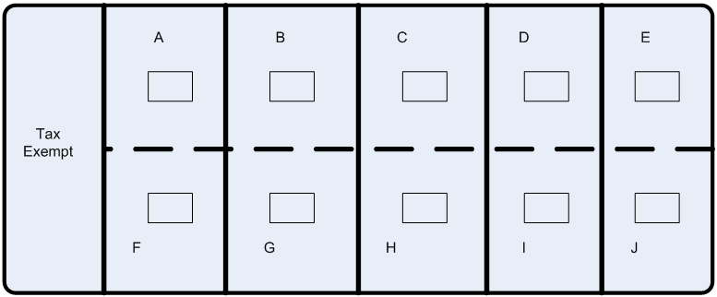
Palm Tree Island

Slide 8
Base Year
Tax Rate $10,000 (Levy) = $.01 (Mill Rate)
$1,000,000 (AV)
Owner | Assessment | Mill Rate | Taxes | % Total Tax
A | $100,000 | 0.01 | $1,000 | 10%
B | $100,000 | 0.01 | $1,000 | 10%
C | $100,000 | 0.01 | $1,000 | 10%
D | $100,000 | 0.01 | $1,000 | 10%
E | $100,000 | 0.01 | $1,000 | 10%
F | $100,000 | 0.01 | $1,000 | 10%
G | $100,000 | 0.01 | $1,000 | 10%
H | $100,000 | 0.01 | $1,000 | 10%
I | $100,000 | 0.01 | $1,000 | 10%
J | $100,000 | 0.01 | $1,000 | 10%
Totals | $1,000,000 (AV) |  | $10,000 (Levy) | 100%

Slide 9
20% Assessment Increase
Tax Rate $10,000 (Levy) = $0.0083333 (Mill Rate)
$1,200,000 (AV)
Owner | Assessment | Mill Rate | Taxes | % Total Tax
A | $120,000 | 0.0083333 | $1,000 | 10%
B | $120,000 | 0.0083333 | $1,000 | 10%
C | $120,000 | 0.0083333 | $1,000 | 10%
D | $120,000 | 0.0083333 | $1,000 | 10%
E | $120,000 | 0.0083333 | $1,000 | 10%
F | $120,000 | 0.0083333 | $1,000 | 10%
G | $120,000 | 0.0083333 | $1,000 | 10%
H | $120,000 | 0.0083333 | $1,000 | 10%
I | $120,000 | 0.0083333 | $1,000 | 10%
J | $120,000 | 0.0083333 | $1,000 | 10%
Totals | $1,200,000 (AV) |  | $10,000 (Levy) | 100%

Slide 10
20% Assessment Decrease
Tax Rate $10,000 (Levy) = $0.0125 (Mill Rate)
$800,000 (AV)
Owner | Assessment | Mill Rate | Taxes | % Total Tax
A | $80,000 | 0.0125 | $1,000 | 10%
B | $80,000 | 0.0125 | $1,000 | 10%
C | $80,000 | 0.0125 | $1,000 | 10%
D | $80,000 | 0.0125 | $1,000 | 10%
E | $80,000 | 0.0125 | $1,000 | 10%
F | $80,000 | 0.0125 | $1,000 | 10%
G | $80,000 | 0.0125 | $1,000 | 10%
H | $80,000 | 0.0125 | $1,000 | 10%
I | $80,000 | 0.0125 | $1,000 | 10%
J | $80,000 | 0.0125 | $1,000 | 10%
Totals | $800,000 |  | $10,000 | 100%

Slide 11
One Property made improvements
Tax Rate $10,000 (Levy) = $0.00995 (Mill Rate)
$1,005,000 (AV)
Owner | Assessment | Mill Rate | Taxes | % Total Tax
A | $105,000 | 0.00995 | $1,045.00 | 10.45%
B | $100,000 | 0.00995 | $995.00 | 9.95%
C | $100,000 | 0.00995 | $995.00 | 9.95%
D | $100,000 | 0.00995 | $995.00 | 9.95%
E | $100,000 | 0.00995 | $995.00 | 9.95%
F | $100,000 | 0.00995 | $995.00 | 9.95%
G | $100,000 | 0.00995 | $995.00 | 9.95%
H | $100,000 | 0.00995 | $995.00 | 9.95%
I | $100,000 | 0.00995 | $995.00 | 9.95%
J | $100,000 | 0.00995 | $995.00 | 9.95%
Totals | $1,005,000 (AV) |  | $10,000 (Levy) | 100%

Slide 12
Will Property Taxes Increase?
Revaluations are revenue neutral; however, some owner’s shares will increase, some will decrease, and some will stay about the same.
Tax impacts can’t be known until November of 2023 after the City, County, Schools and Blackhawk Tech complete their 2024 levies.
Assessments are only one factor in the calculation of taxes.
Assessments only determine each owner’s share of the total tax.

Slide 13
Sunshine Island

Slide 14
Tax Distribution / Collection
Tax Rate $10,000 (Levy) = .0071428 (Mill Rate)
$1,400,000 (AV)
Owner | Assessment | Mill Rate | Taxes | % Total Value & Total Tax
A | $100,000 | 0.0071428 | $714.28 | 7%
B | $100,000 | 0.0071428 | $714.28 | 7%
C | $100,000 | 0.0071428 | $714.28 | 7%
D | $150,000 | 0.0071428 | $1,071.42 | 11%
E | $150,000 | 0.0071428 | $1,071.42 | 11%
F | $200,000 | 0.0071428 | $1,428.56 | 14%
G | $200,000 | 0.0071428 | $1,428.56 | 14%
H | $200,000 | 0.0071428 | $1,428.56 | 14%
I | $200,000 | 0.0071428 | $1,428.56 | 14%
Totals | $1,400,000 (AV) |  | $10,000 (Levy) | 100%

Slide 15
Revaluation
Average Increase 63%
Owner | Prior Year Values | Proposed Values | %CHANGE | Mill Rate | Proposed Tax | Prior Year Tax | Tax Change
A | $100,000 | $140,000 | 40% | 0.0043699 | $611.78 | $714.28 | -$102.50
B | $100,000 | $140,000 | 40% | 0.0043699 | $611.78 | $714.28 | -$102.50
C | $100,000 | $140,000 | 40% | 0.0043699 | $611.78 | $714.28 | -$102.50
D | $150,000 | $200,000 | 33% | 0.0043699 | $873.97 | $1,071.42 | -$197.45
E | $150,000 | $200,000 | 33% | 0.0043699 | $873.97 | $1,071.42 | -$197.45
F | $200,000 | $326,700 | 63% | 0.0043699 | $1,427.64 | $1,428.56 | -$0.92
G | $200,000 | $326,700 | 63% | 0.0043699 | $1,427.64 | $1,428.56 | -$0.92
H | $200,000 | $375,000 | 88% | 0.0043699 | $1,638.70 | $1,428.56 | $210.14
I | $200,000 | $440,000 | 120% | 0.0043699 | $1,952.74 | $1,458.56 | $494.18
Totals | $1,000,000(AV) | $2,288,400(AV) | Average Change 63% | 0.0043699 | $10,000.00 | $10,000.00

Slide 16
Data Used for Revaluation
Revaluations estimate the value of property based on Market Values.
  Market Value – selling price realized through informed, open and competitive negotiation absent of any duress.
  Arm’s Length sales – exclude transfers or partial interest, estate planning, related parties, foreclosures and other distressed sales.
  Standard is Market Value, not liquidation value.

Slide 17
Arm’s Length
Arm’s-Length:
  Knowledgeable Seller.
  Knowledgeable Buyer.
  Reasonable exposure in an open & competitive market.
  Payment in cash or conventional financing.
  Neither party is compelled to participate (no duress).
  Sale Price represents normal consideration for property sold.

Slide 18
Assessment Ratio
Assessment = Individual Ratio
Sale Price
Total City Assessed Value = Aggregate Ratio
Total City Sales Prices
  State law establishes assessments are in compliance when they are within 90-110% of market value.

Slide 19
Year | 2011 (reval) | 2012 | 2013 | 2014 | 2015 | 2016 | 2017 | 2018 | 2019 (reval) | 2020 | 2021 | 2022 (Est.)
%FV | 97.40 | 99.72 | 102.8 | 97.81 | 99.14 | 95.51 | 88.20 | 82.81 | 95.07 | 90.27 | 85.08 | 72.00

Slide 20
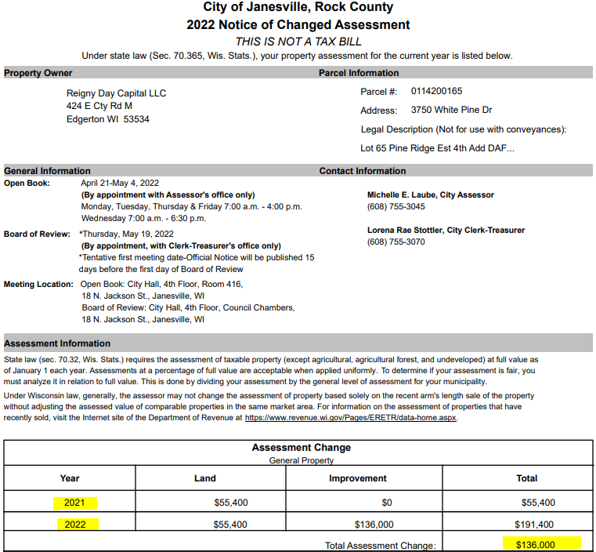

Slide 21
What Happens after I get my Assessment Change Notice?
Review the Assessment Change Notice and its informational insert(s).
Calculate your percent change and compare that to the average assessment change for all property in the City.
Determine if the new assessment is a reasonable estimate of market value for your home.

Slide 22
After I get my Assessment Change Notice cont.
State law establishes assessments are correct when they are within 90-110% of market value.
If it seems outside of the range, review your property record card information on the City of Janesville’s website for accuracy.
www.janesvillewi.gov
Consider factors that might have occurred with your property.
  Since 2019
  Addition, remodeling or deletions

Slide 23
Optional Next Steps
Do Nothing – Assessment is accurate, reasonable, and equitable.
Open Book – Assessment is factually inaccurate or outside a reasonable range of Arm’s Length sales prices (90-110%).
Board of Review – If you continue to believe your assessment does not represent Market Value.
Open Book and Board of Review are done by appointment only.
Open Book and Board of Review discussions are not about property taxes – only property values.

Slide 24
Proportional Distribution
Revaluations are Revenue Neutral, they are not completed to increase tax collection.
Revaluations are completed to proportionately distribute the total tax to be collected based on the individual market values of each property.
Required because all properties are not the same and market values change at different rates.

Slide 25
Why don’t we revalue every year?
  Not required by Wis. Stats.
  Typically values only change 2 – 4% a year.
  Challenging, labor intensive and expensive.
  Estimated cost for 2023: $50,000-60,000

Slide 26
Property Tax Summary
Pays for local services & infrastructure
Services provided by the County, City, Blackhawk Tech & Janesville and/or Milton K-12 Schools
Cost of services are distributed proportionately based on individual assessed values
Process provides opportunities for property owners to participate

Slide 27
Need More Information?
Frequent the Assessor’s Office section of the City’s website.
  www.janesvillewi.gov
  As new tools and information become available, they will be posted to the Assessor section of the city’s website.
    Arm’s Length sale information
    Average Assessment Change
    Estimate Tax Calculator

Slide 28





Thank you for your time.
Please contact the Assessor’s Office for more information.
(608) 755-3045
www.janesvillewi.gov

